Slide 1


Slide 2
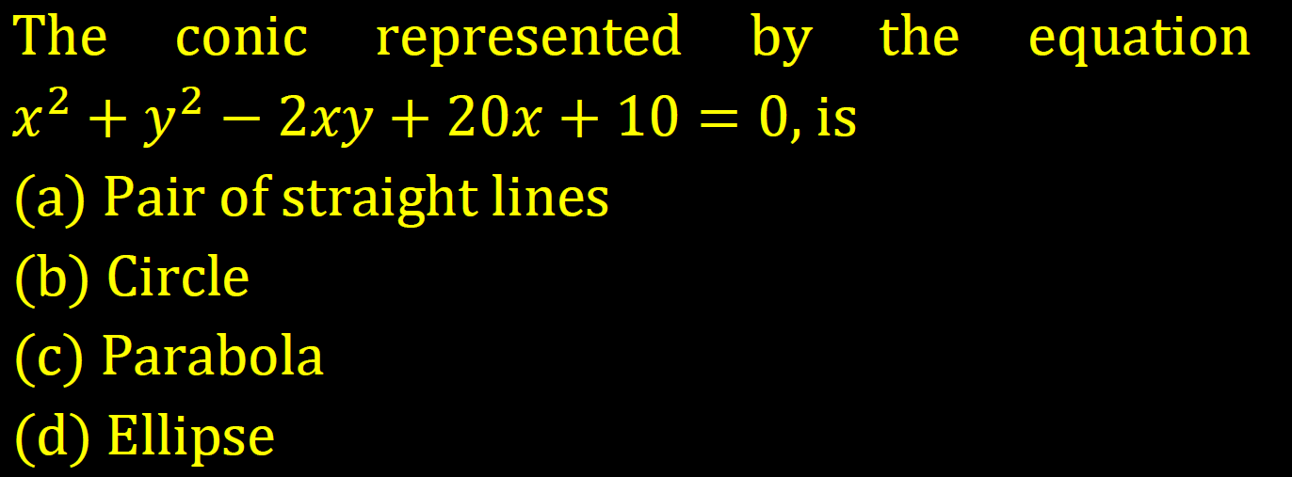

Slide 3
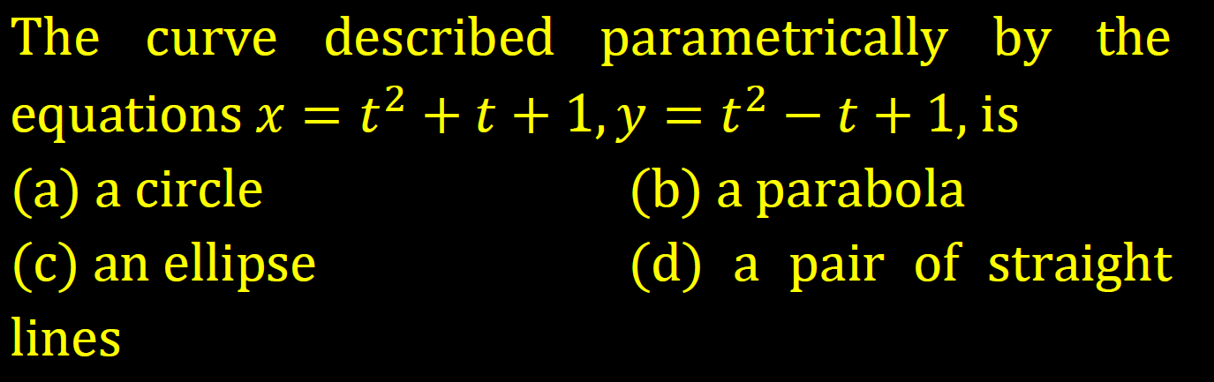

Slide 4
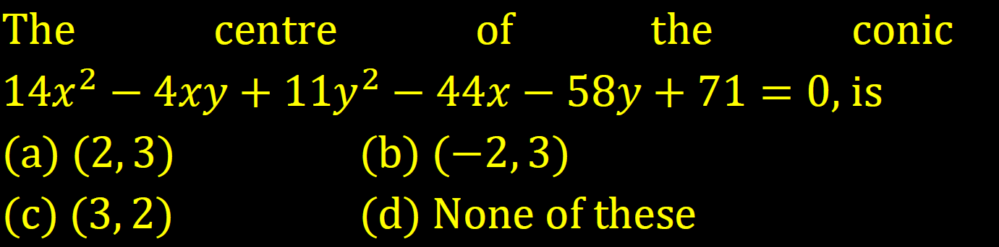

Slide 5
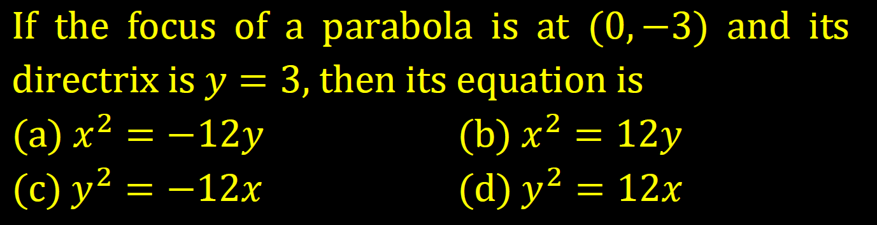

Slide 6
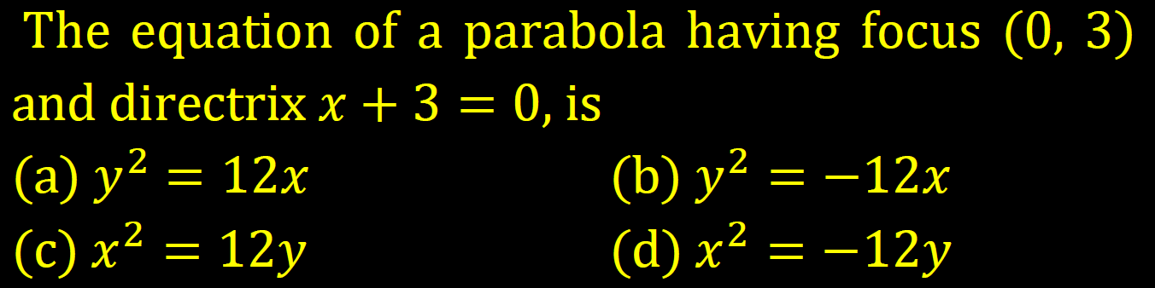

Slide 7
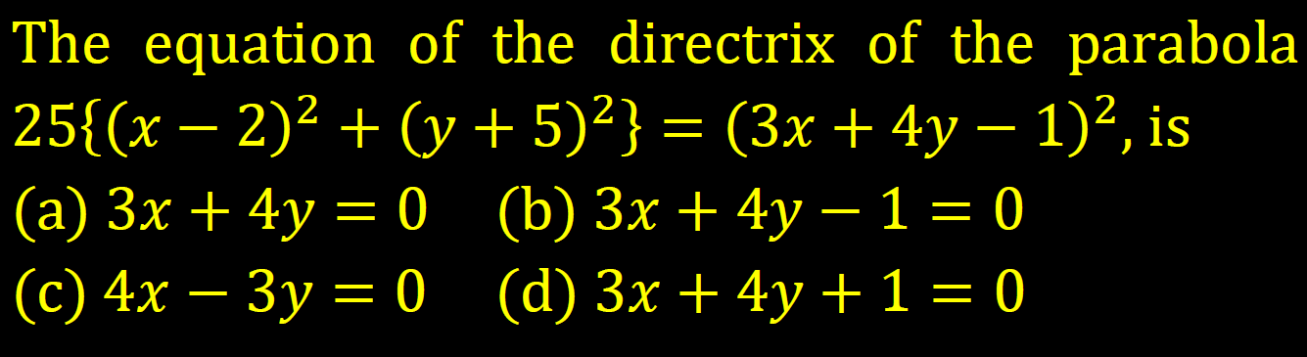

Slide 8
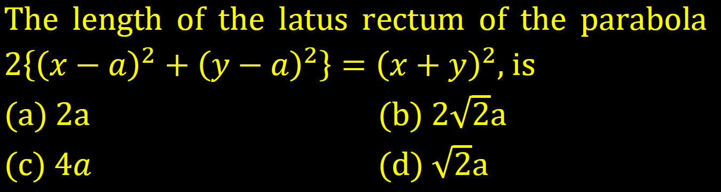

Slide 9
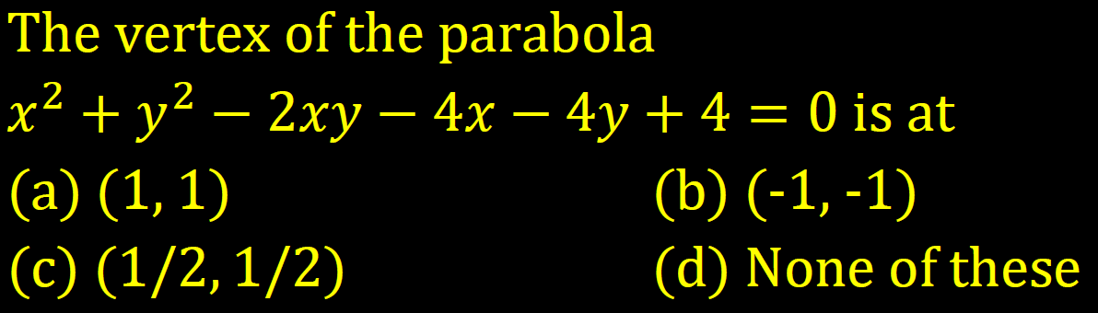

Slide 10
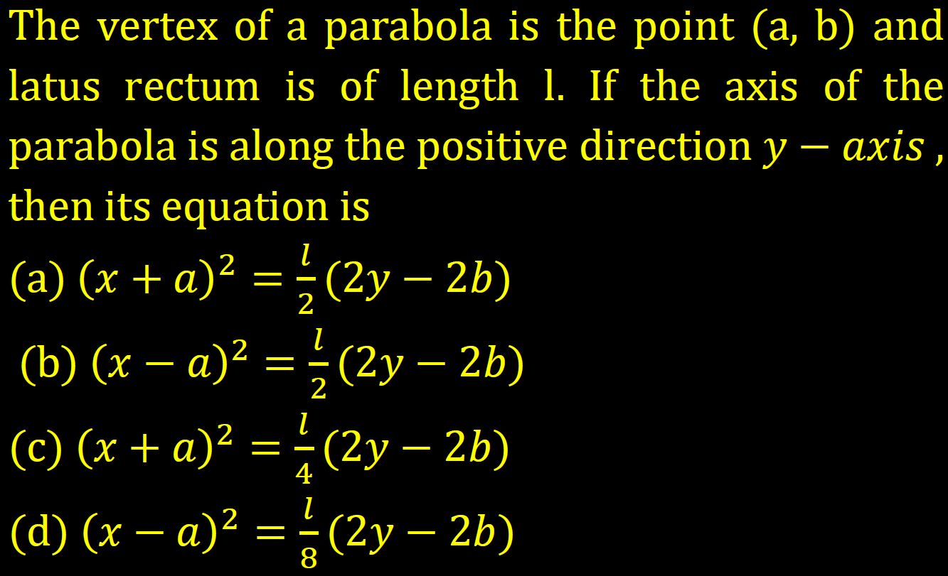

Slide 11
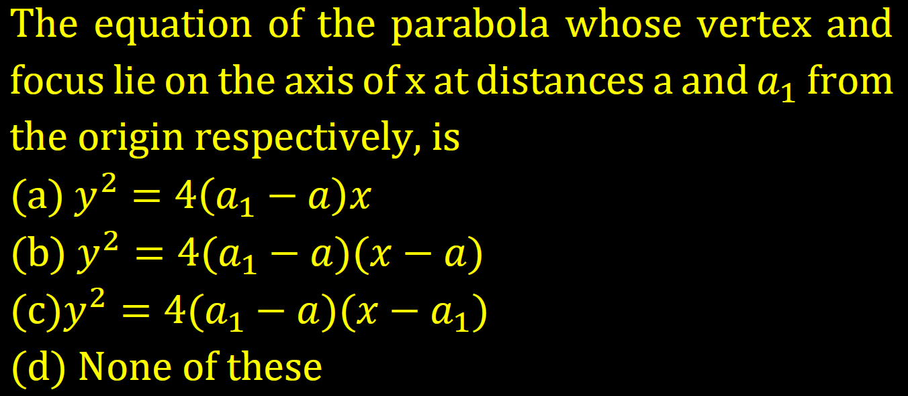

Slide 12
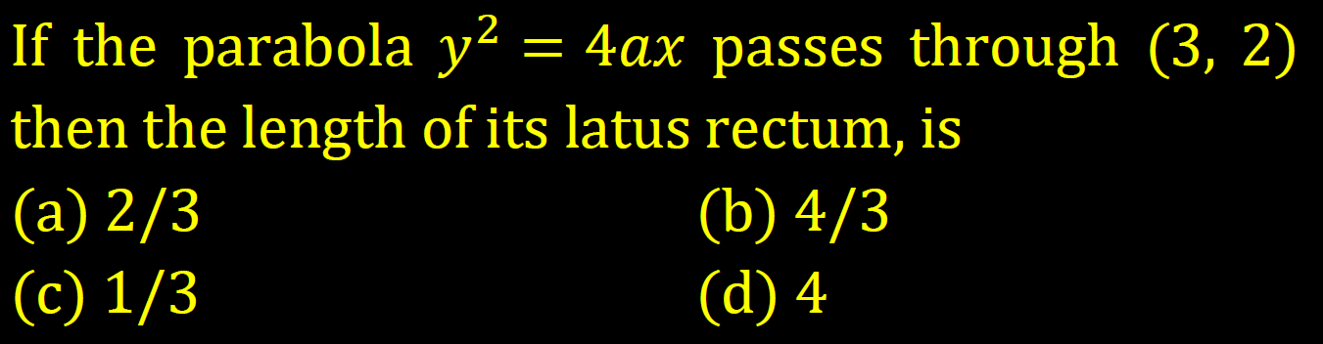

Slide 13
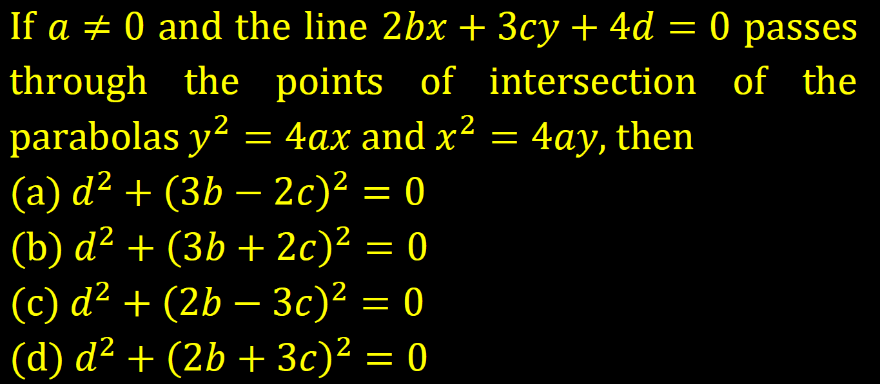

Slide 14
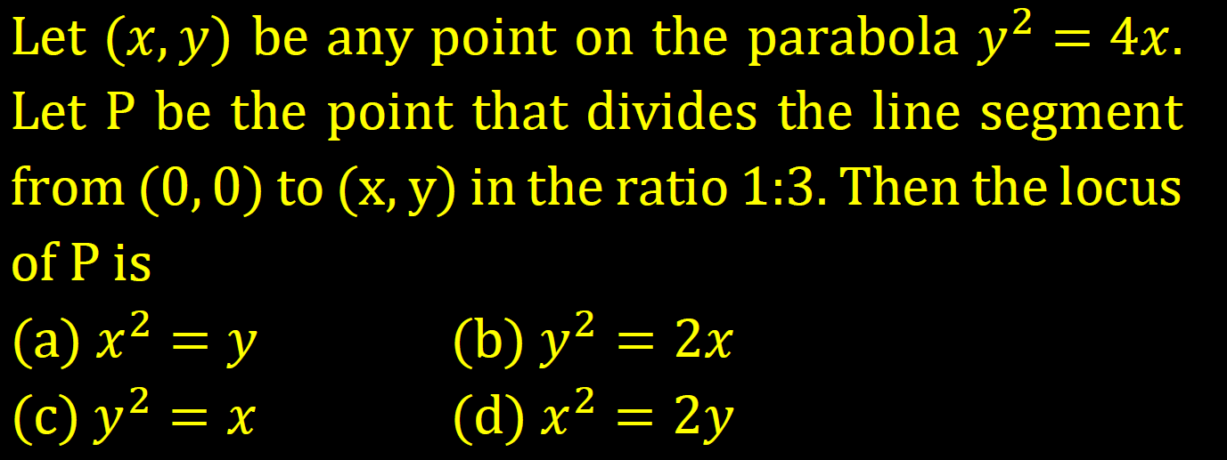

Slide 15
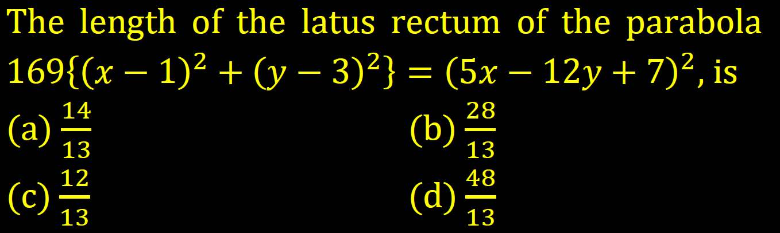

Slide 16
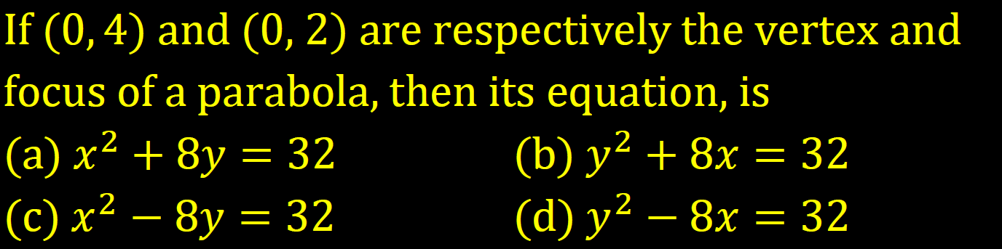

Slide 17
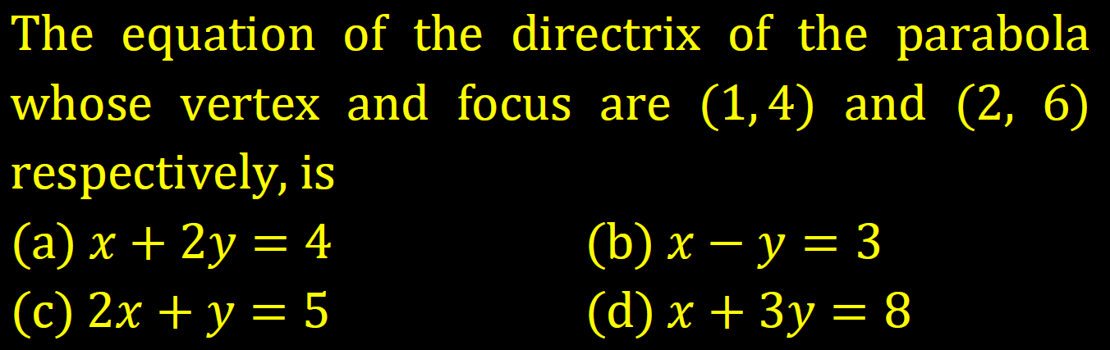

Slide 18
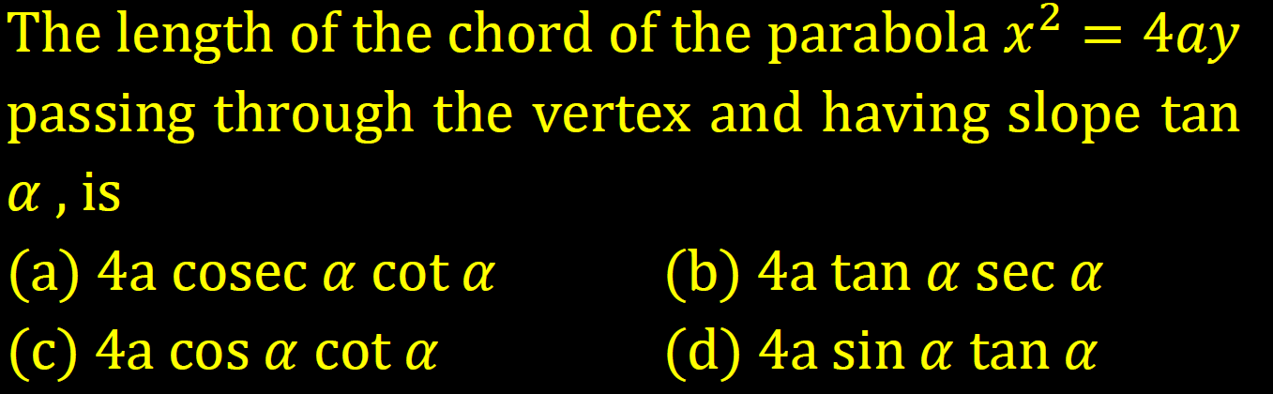

Slide 19
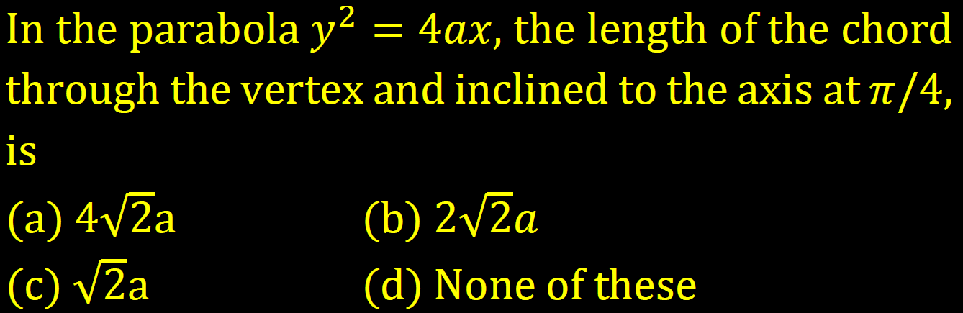

Slide 20
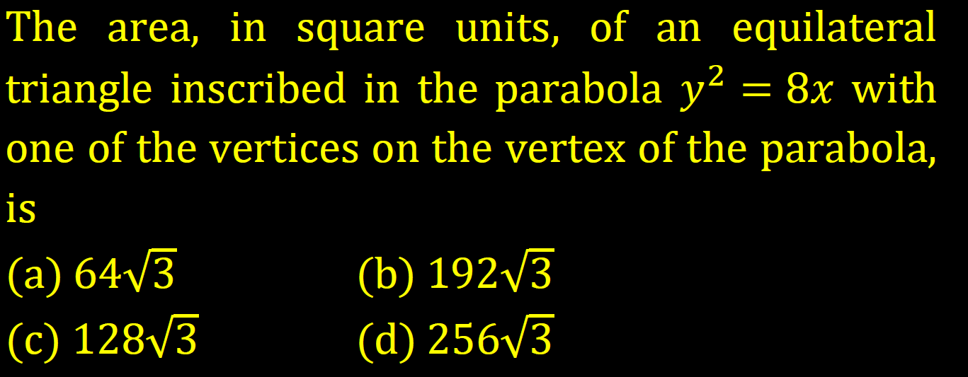

Slide 21
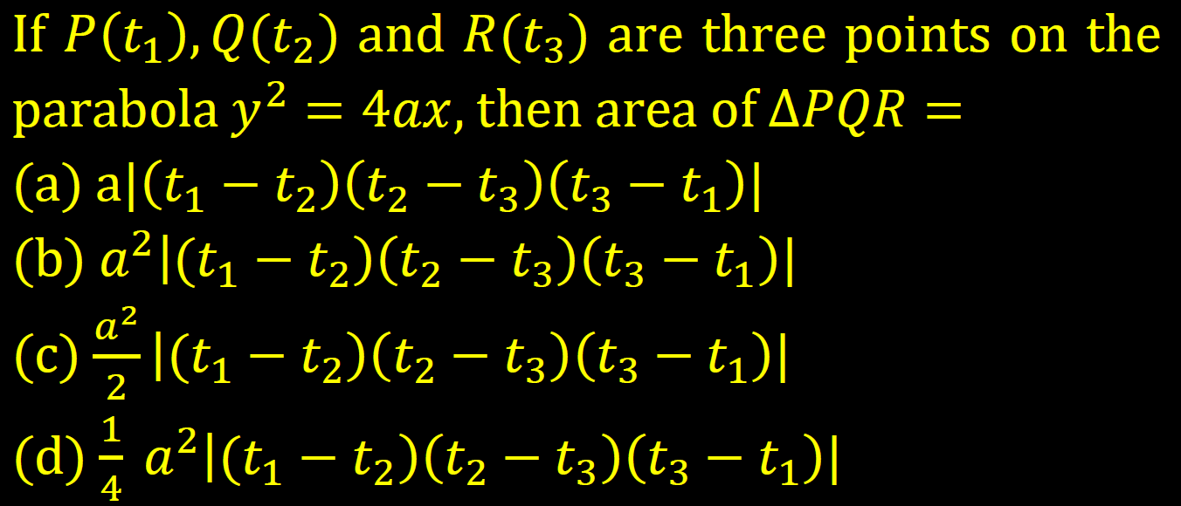

Slide 22
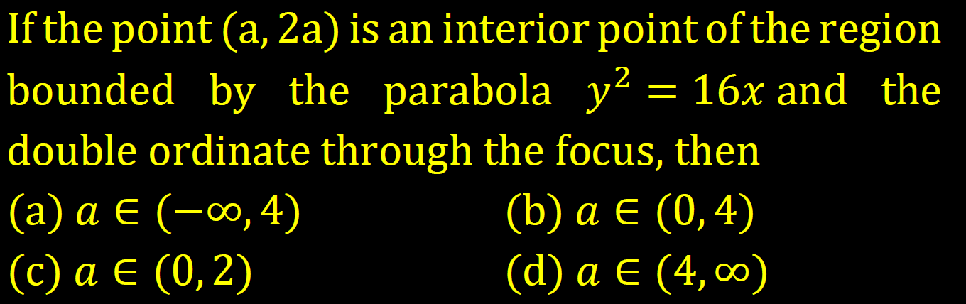

Slide 24
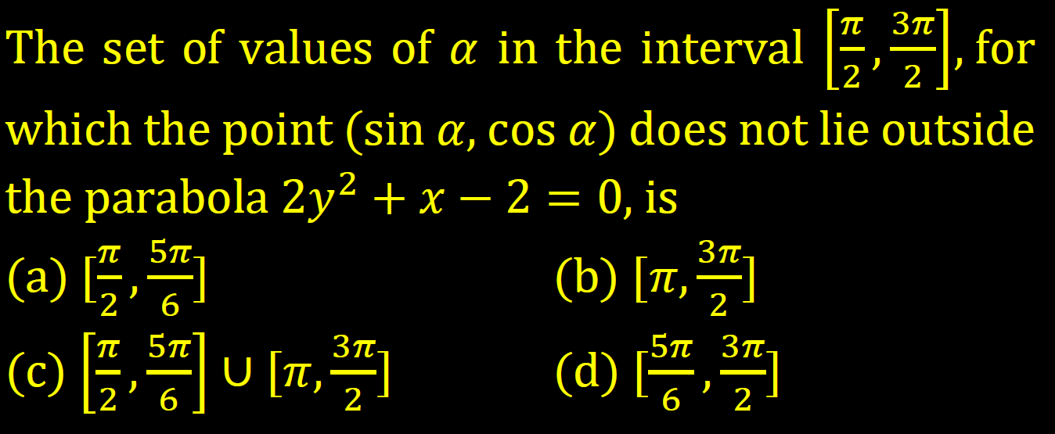

Slide 25
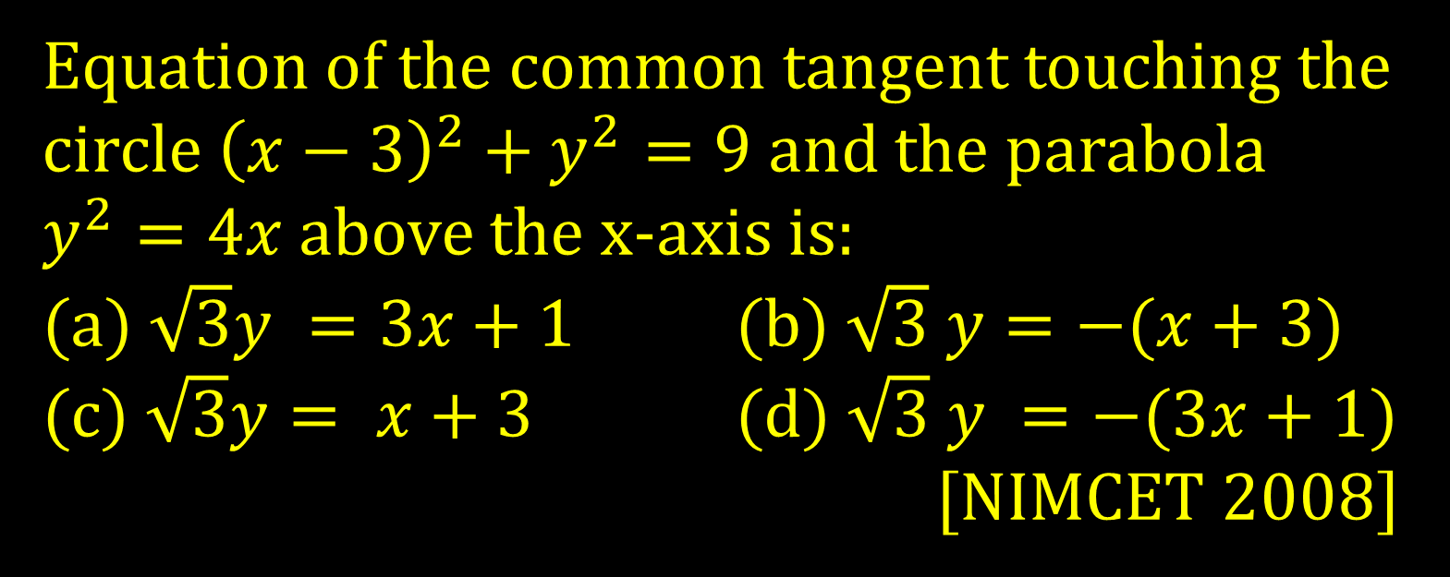
Equation of the common tangent touching the circle ${\left(x−3\right)}^{2}+y^{2}=9$ and the parabola $y^{2}=4x$ above the x-axis is:
(a) $\sqrt{3}y =3x+1$ (b) $\sqrt{3} y=−(x+3)$
(c) $\sqrt{3}y= x+3$ (d) $\sqrt{3} y =−(3x+1)$
[NIMCET 2008]

Slide 26
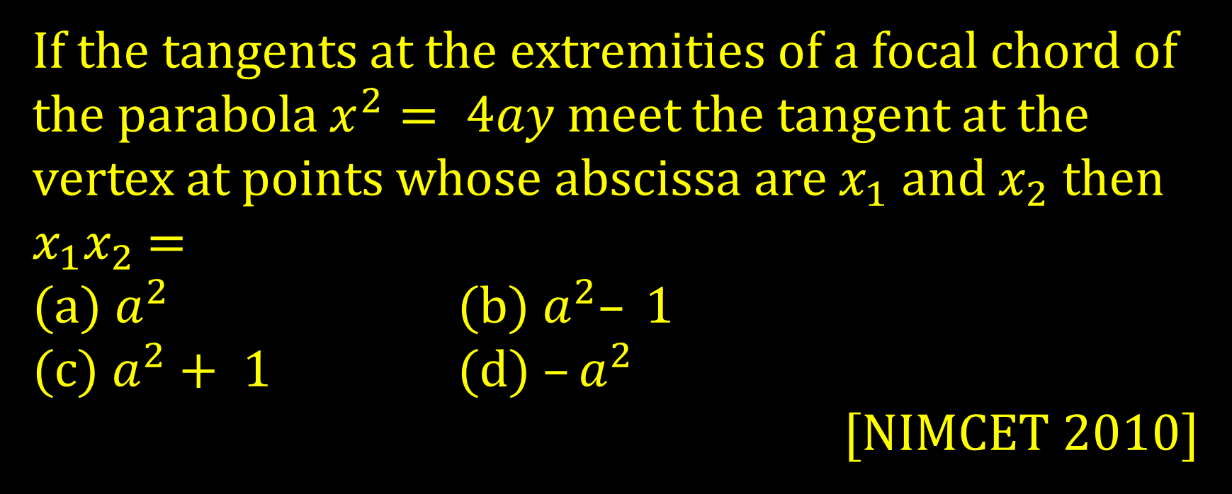
If the tangents at the extremities of a focal chord of the parabola $x^{2}= 4ay$ meet the tangent at the vertex at points whose abscissa are $x_{1}$ and $x_{2}$ then $x_{1}x_{2}$ =
(a) $a^{2}$ (b) $a^{2}– 1$
(c) $a^{2}+ 1$ (d) $–a^{2}$
[NIMCET 2010]

Slide 27
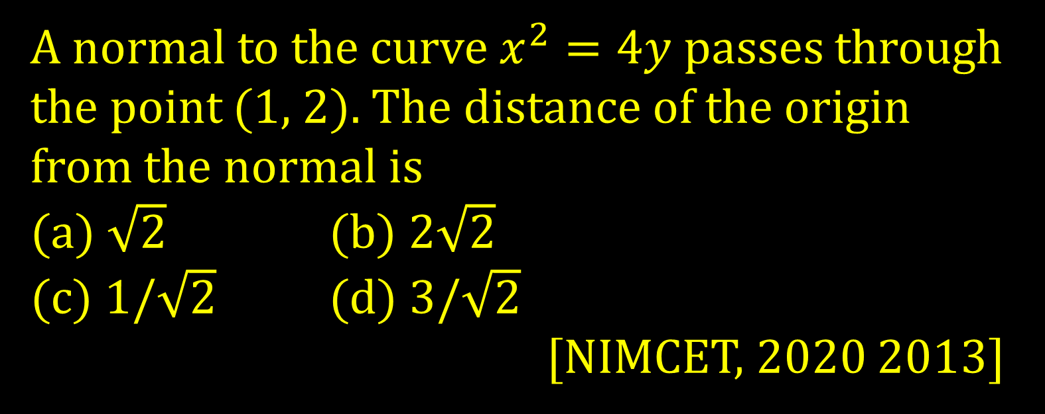
A normal to the curve $x^{2}=4y$ passes through the point (1, 2). The distance of the origin from the normal is
(a) $\sqrt{2}$ (b) $2\sqrt{2}$
(c) $1/\sqrt{2}$ (d) $3/\sqrt{2}$
[NIMCET, 2020 2013]

Slide 28
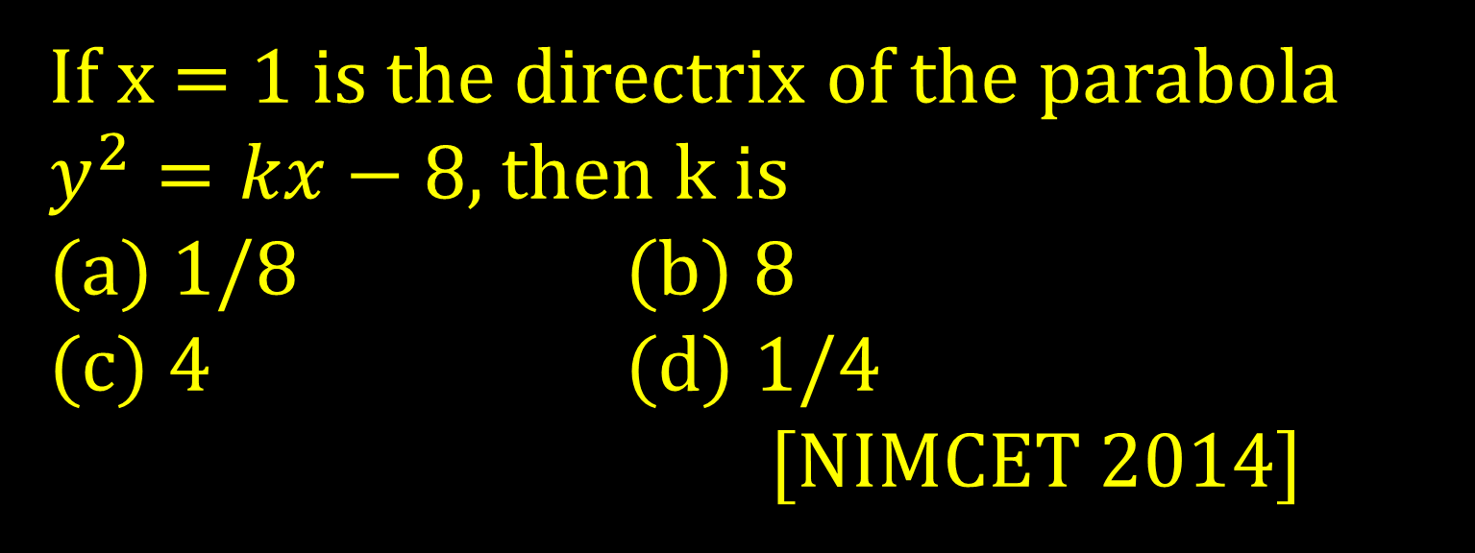
If x = 1 is the directrix of the parabola $y^{2}=kx−8$, then k is
(a) 1/8 (b) 8
(c) 4 (d) 1/4
[NIMCET 2014]

Slide 29
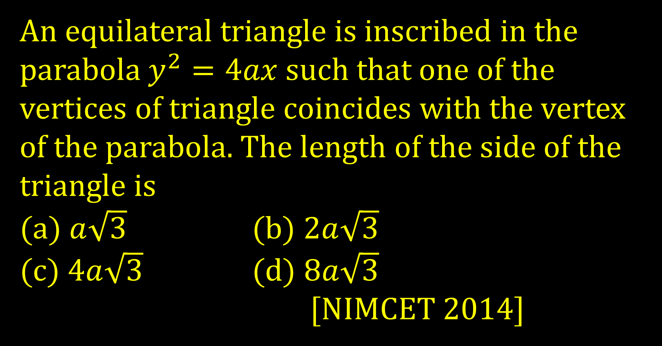
An equilateral triangle is inscribed in the parabola $y^{2}=4ax$ such that one of the vertices of triangle coincides with the vertex of the parabola. The length of the side of the triangle is
(a) $a\sqrt{3}$ (b) $2a\sqrt{3}$
(c) $4a\sqrt{3}$ (d) $8a\sqrt{3}$
[NIMCET 2014]

Slide 30
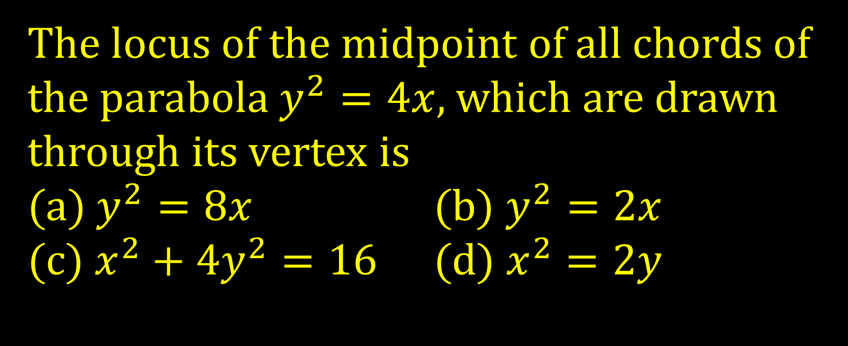
The locus of the midpoint of all chords of the parabola $y^{2}=4x$, which are drawn through its vertex is
(a)$y^{2}=8x$ (b) $y^{2}=2x$
(c) $x^{2}+4y^{2}=16$ (d) $x^{2}=2y$

Slide 31
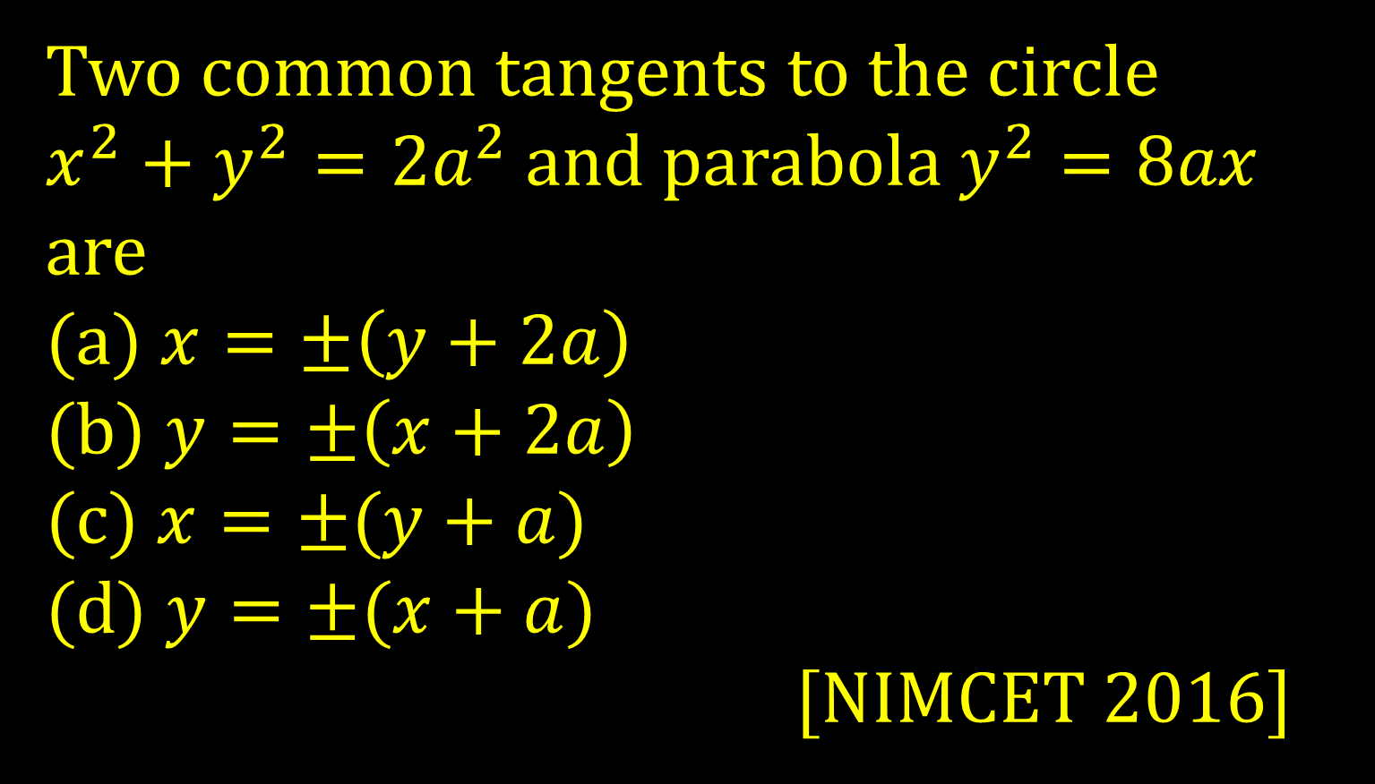
Two common tangents to the circle
$x^{2}+y^{2}=2a^{2}$ and parabola $y^{2}=8ax$ are
(a) $x=±\left(y+2a\right)$
(b) $y=±\left(x+2a\right)$
(c) $x=±(y+a)$
(d) $y=±(x+a)$
[NIMCET 2016]

Slide 32
The vertex of the parabola whose focus is (-1,1) and directrix is 4x+3y-24=0 is
(a) (0, 3/2) (b) (0, 5/2)
(c) (1, 3/2) (d) (1, 5/2)
[NIMCET 2016]

